Slide 1
HR Analytics - Attrition Prediction
Using Python Jupiter Notebook to perform EDA

Slide 2
HR Analytics - Attrition Prediction
My client is a large MNC and they have 9 broad verticals across the organisation. One of the problem my client is facing is around identifying the people who are at risk of "attrition".
The company needs a help in identifying the probable candidates at a particular checkpoint so that they can take preventive measures to mitigate the "attrition risk".
Column Name | Description
Age | Age Details
Attrition | Attrition Details
BusinessTravel | BusinessTravel Details
DailyRate | DailyRate Details
Department | Department Details
DistanceFromHome | DistanceFromHome Details
Education | Education Details
EducationField | EducationField Details
EmployeeCount | EmployeeCount Details
EmployeeNumber | EmployeeNumber Details
EnvironmentSatisfaction | EnvironmentSatisfaction Details
Gender | Gender Details
HourlyRate | HourlyRate Details
JobInvolvement | JobInvolvement Details
JobLevel | JobLevel Details
JobRole | JobRole Details
JobSatisfaction | JobSatisfaction Details
MaritalStatus | MaritalStatus Details
MonthlyIncome | MonthlyIncome Details
MonthlyRate | MonthlyRate Details
NumCompaniesWorked | NumCompaniesWorked Details
Over18 | Over18 Details
OverTime | OverTime Details
PercentSalaryHike | PercentSalaryHike Details
PerformanceRating | PerformanceRating Details
RelationshipSatisfaction | RelationshipSatisfaction Details
StandardHours | StandardHours Details
StockOptionLevel | StockOptionLevel Details
TotalWorkingYears | TotalWorkingYears Details
TrainingTimesLastYear | TrainingTimesLastYear Details
WorkLifeBalance | WorkLifeBalance Details
YearsAtCompany | YearsAtCompany Details
YearsInCurrentRole | YearsInCurrentRole Details
YearsSinceLastPromotion | YearsSinceLastPromotion Details
YearsWithCurrManager | YearsWithCurrManager Detai
The goal is to identify all the employees who are at risk of attrition at a given cycle so that HR can take timely actions to mitigate the risk.

Slide 3
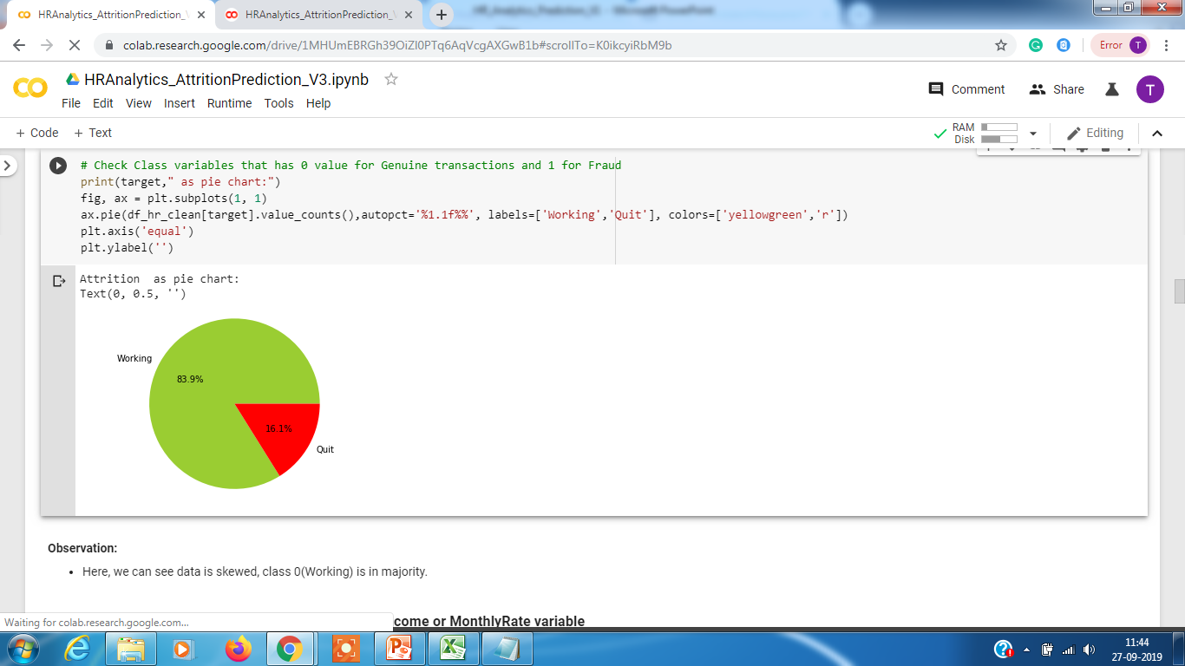
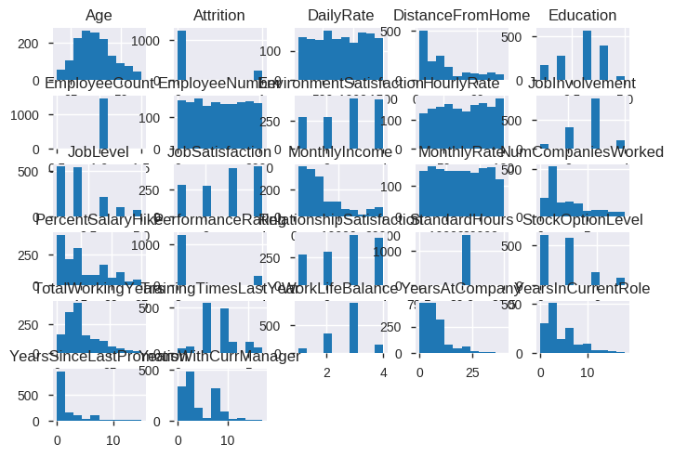
HR Analytics – Attrition Dataset
Checking the distribution of attrition vs non attrition using PIE
Also while checking the data distribution using histogram, we observe that data is not normally distributed for education , no companies worked, performance rating, education, job level, work life balance, standard hours, stock option level as they are all categorical with certain scores. These will have to normalized.

Slide 4
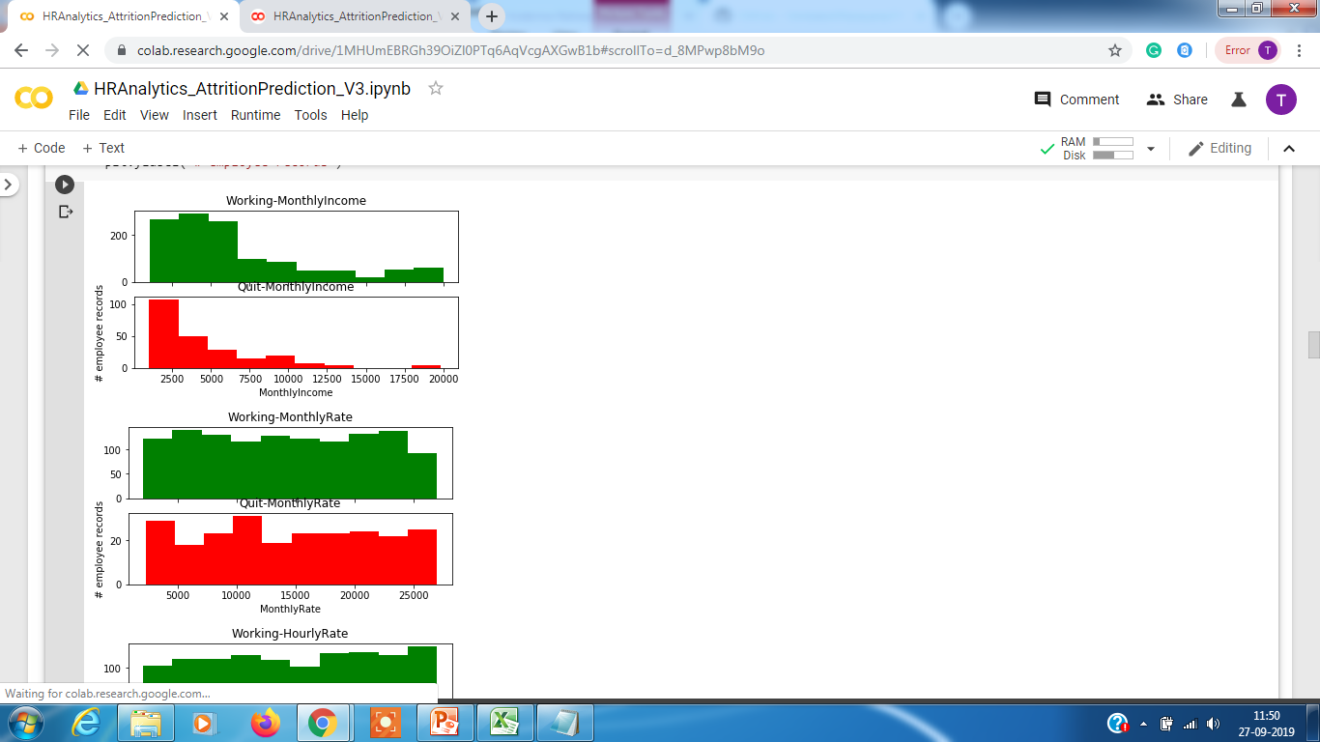
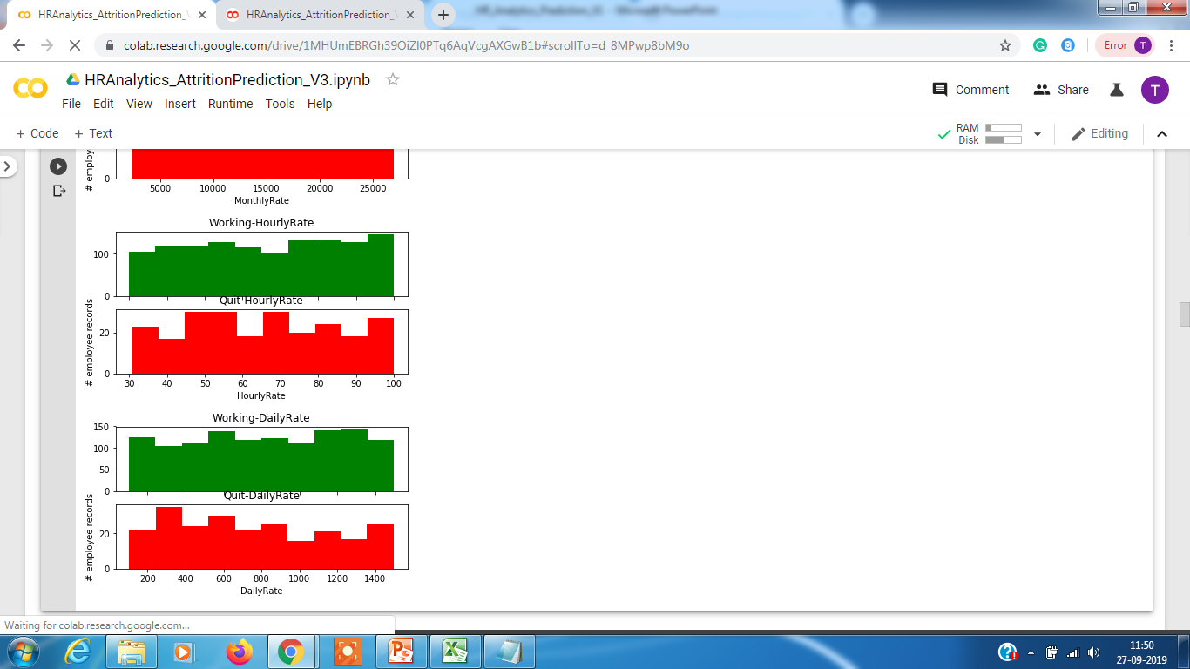
HR Analytics – Attrition Dataset
Plotting histograms to see if 'MonthlyIncome','MonthlyRate','HourlyRate','DailyRate’ has any influence on attrition data vs non attrition
There are no distinguishing factors as we see distribution to be almost same in both attrition and non attrition cases.

Slide 5
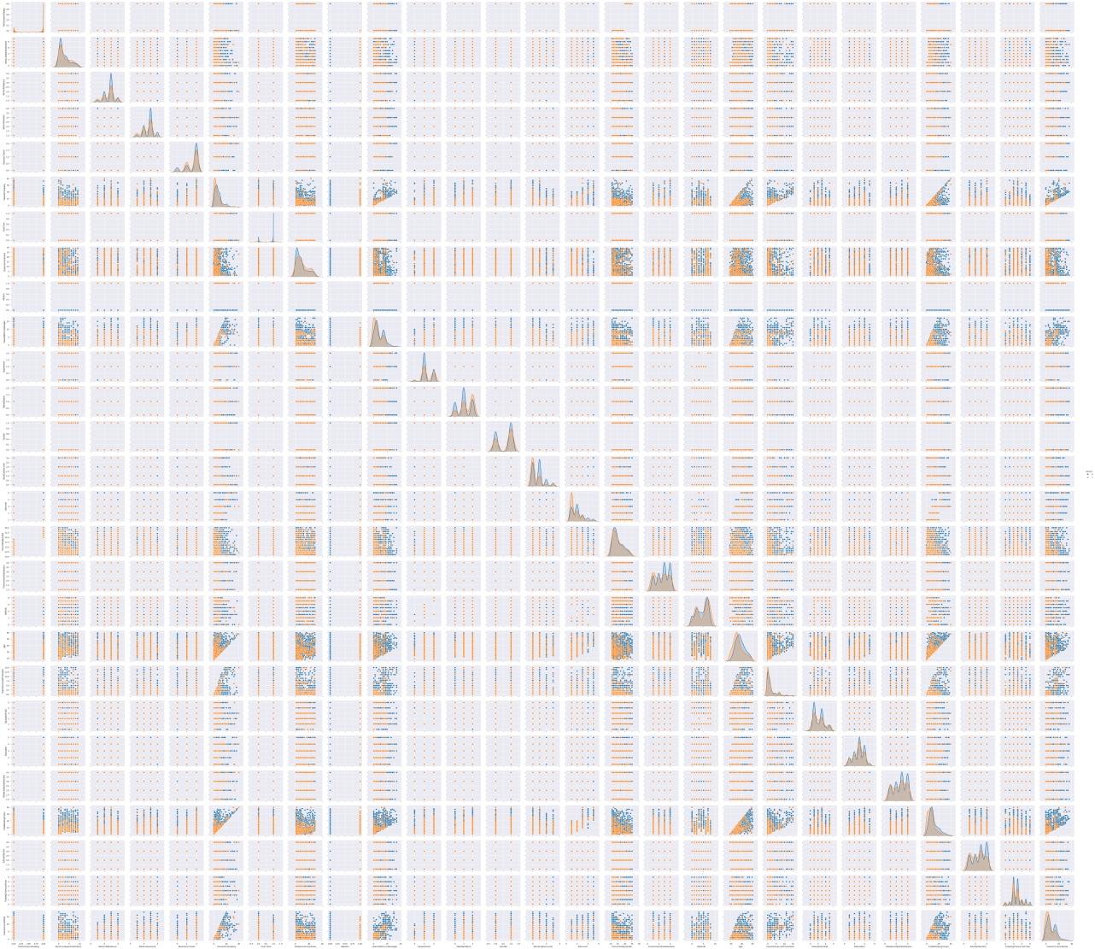
HR Analytics – Attrition Dataset
Plotting a pair plot and scatter plot to check correlation
Since the data is large and not easy to comprehend we go for heatmap.

Slide 6
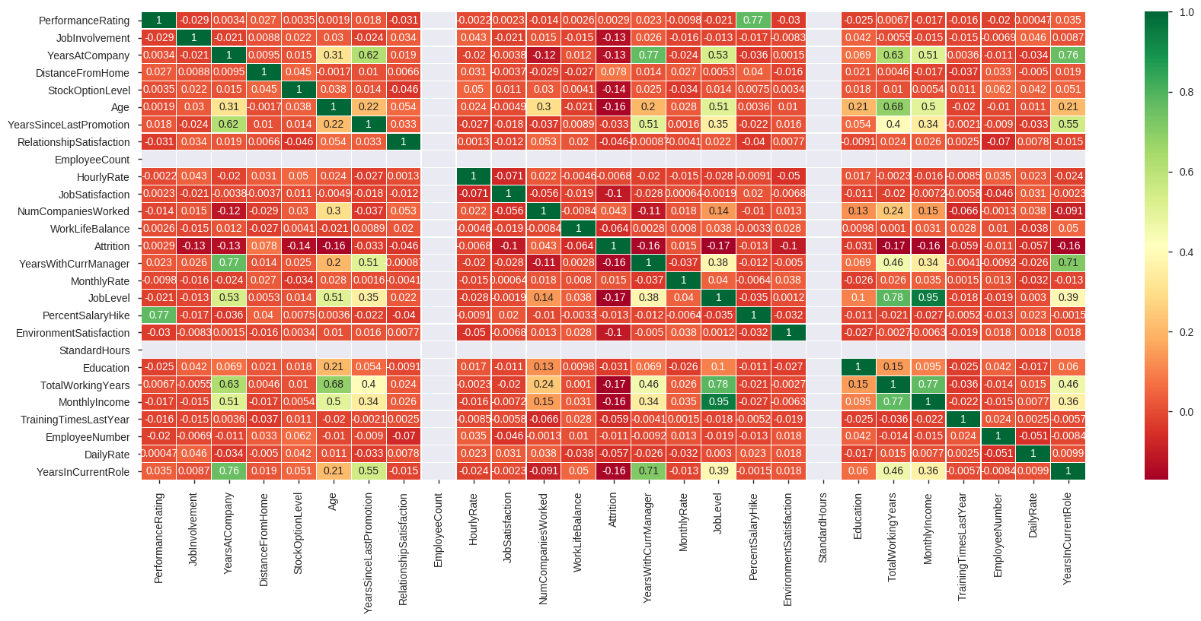
HR Analytics – Attrition Dataset
Establishing correlation between all the features using heatmap.
As shown above, “Monthly Rate”, “Number of Companies Worked” and “Distance From Home” are positively correlated to Attrition
Also, "Job Involvement","Monthly Income", “Job Level”,"Years at company", “Total Working Years”, "Stock Option Level", “Years In Current Role”, "Years with Current Manager" and "Environment Satisfaction" are negatively correlated to Attrition.

Slide 7
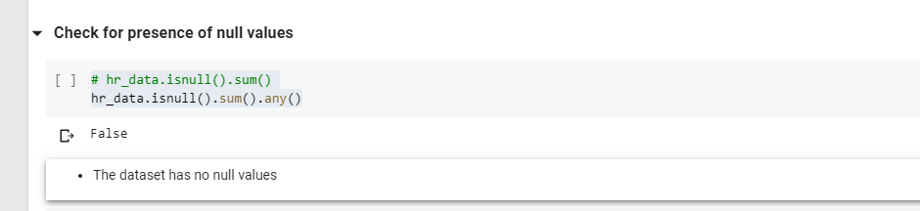
HR Analytics – Attrition Dataset
Checking for Null Values
We do not see any Null Values present. Hence data looks clean.

Slide 8
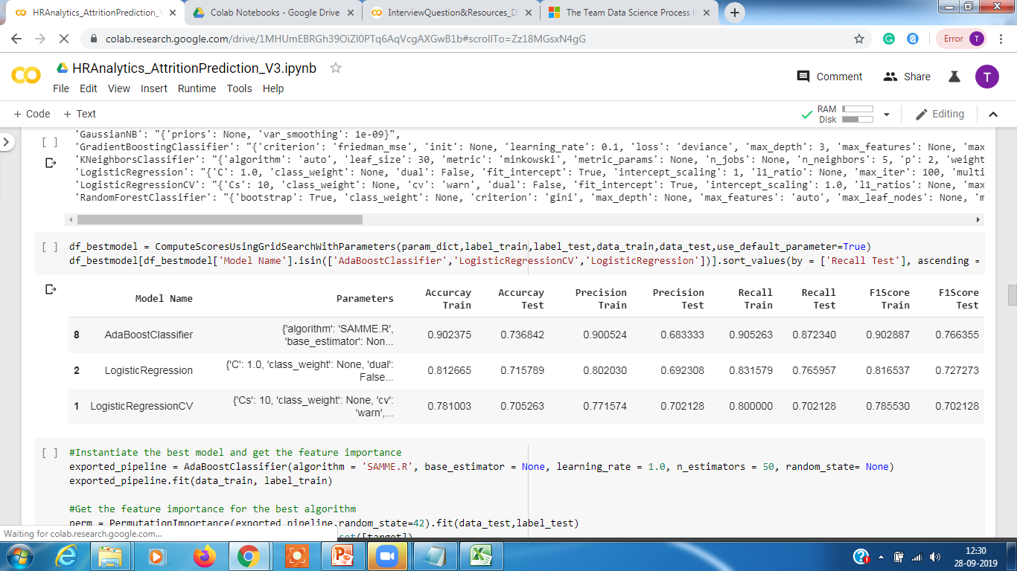
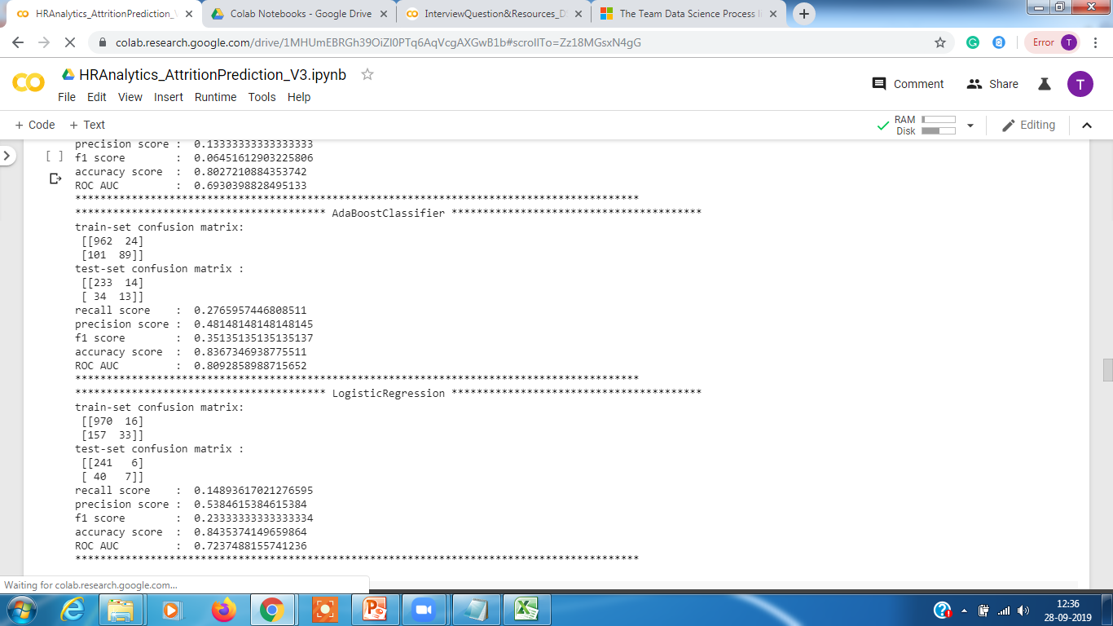
HR Analytics – Model Evaluation
The goal of this problem statement is to achieve high recall score with a decent precision.
Approach 1 : We started our endeavour by first trying the approach of using a balanced dataset by using Undersampling and SMOTE
Observation : A model was trained using the new UNDER SAMPLED dataset and using a grid search on the parameters it gave AdaboostClassifier with 87% Recall and 68% precision and Logistics gave 76% recall and 69% precision.
However, when the model was tested against the FULL dataset the recall and precision dropped tremendously. The Logistic Regression gave 14% recall and precision 53% and for AdaboosterClassifier which gave 27% recall and 48% precision. Though this is not a good model by any means we will use this to set it as our benchmark.

Slide 9
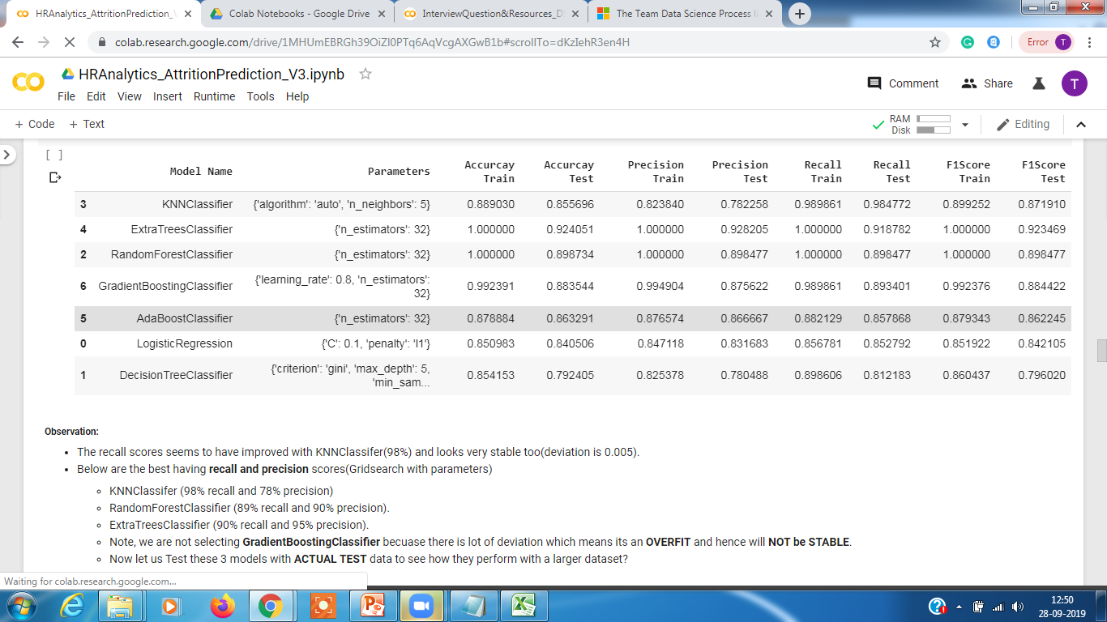
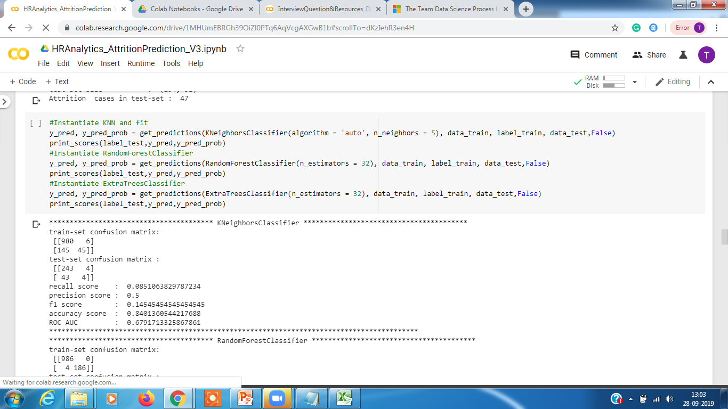
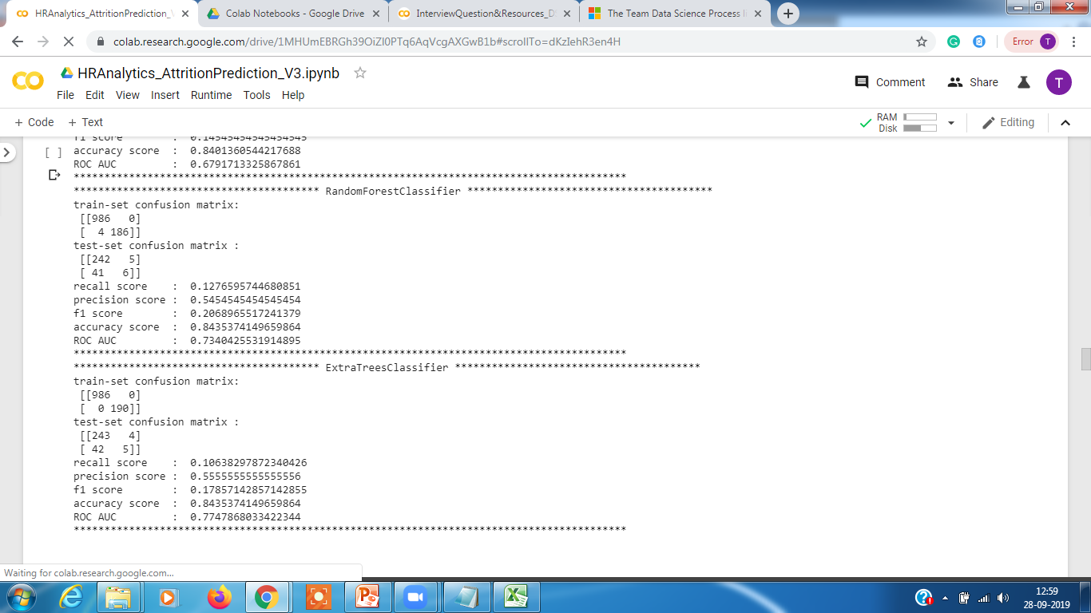
HR Analytics – Model Evaluation
Approach 1 : Creating a balanced dataset by using SMOTE
Observation : Using grid search we got KNNClassifier with 98% Recall and 78% precision and ExtraTreeClassifier gave 91% recall and 92% precision.
However, when the model was tested against the FULL dataset the recall and precision dropped tremendously. The KNN gave 5% recall and precision 50% and ExtraTreeClassifier gave 10% recall and 55% precision. Since these model do not improve our benchmark scores we discard them.

Slide 10
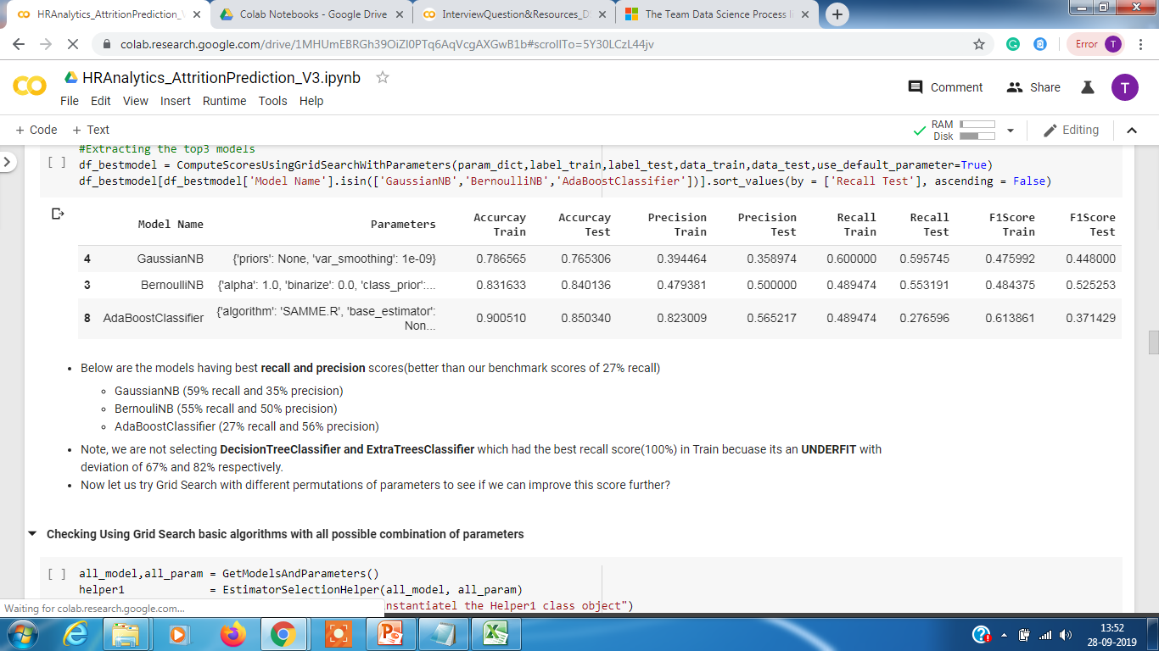
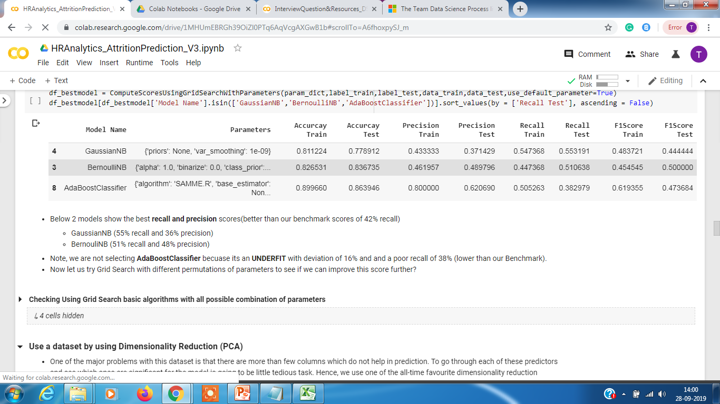
HR Analytics – Model Evaluation
Approach 2 : The second approach we tried using the complete dataset but dropping columns where data was constant like employee id etc.
Observation : We got the best model as GaussianNB with score 59% and precision 35% and BernoulliNB with score 55% and precision 50%. And since this is better than our first approach (recall score of 27% and precision 48%) we will establish this as our new BENCHMARK.
Approach 3 : The third approach we tried was trying to drop a few columns like employee number, monthly income, monthly rate, hourly rate and daily rate as they showed no relation with attrition.
Observation : We got the best But, the best score we achieved was for GaussianNB with 55% recall and 37% precision (BernoulliNB 51% recall and 46% precision). But this doesn't improve on our new BENCHMARK(recall - 59% and precision - 35%). Hence we discard this model

Slide 11
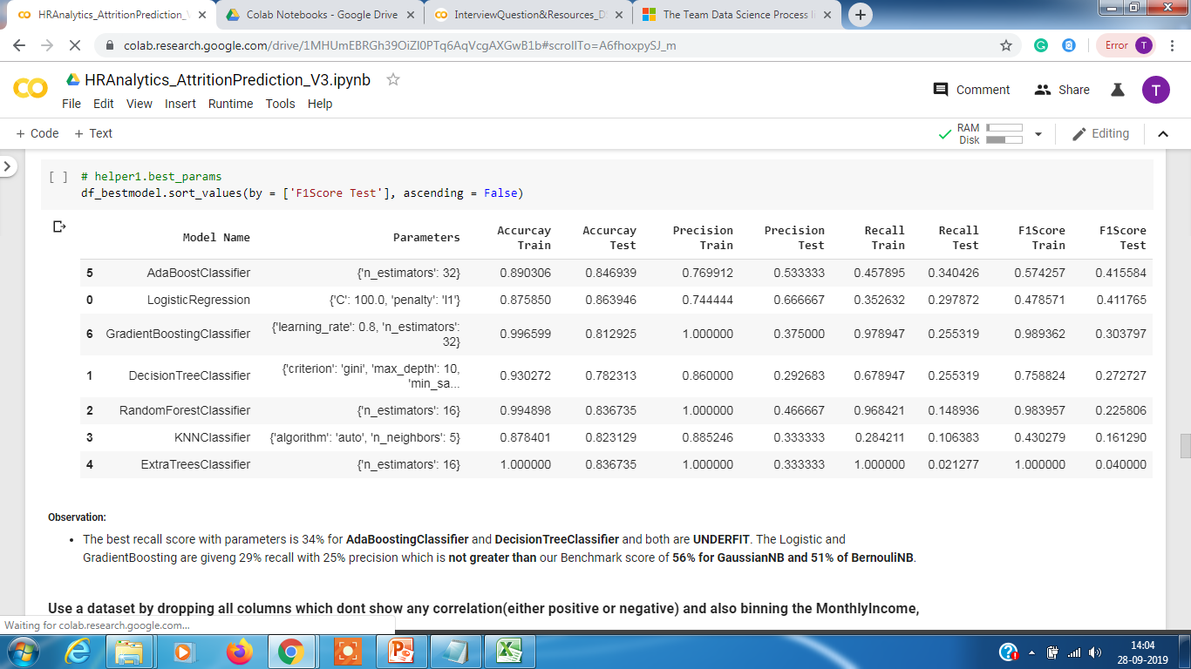
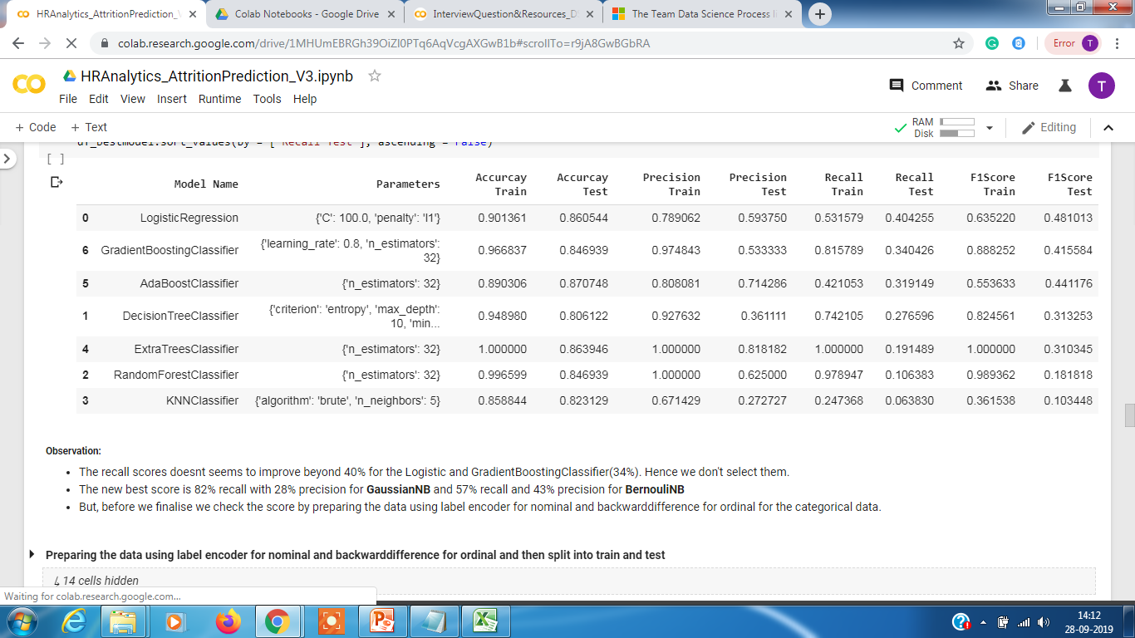
HR Analytics – Model Evaluation
Approach 4 : The fourth approach we tried was trying dimensionality reduction using PCA. We were able to identify 27 columns which attributed to about 95% of the variation in 45 column.
Observation : The best recall score we got was 36% from AdaboostClassifier (and this is an Under fit which showed 19% variation from the trained model) and is unstable. And this doesn't improve on our new BENCHMARK (recall - 59% and precision - 35%).
Approach 5 : The fifth approach is to drop all columns which don't show any correlation(either positive or negative) and also binning the Monthly Income, Monthly Rate, Daily Rate and Age to normalise the data.
Observation : The recall scores doesn't seems to improve beyond 40% for the Logistic and GradientBoostingClassifier (34%). Hence we don't select them. The new best score is 82% recall with 28% precision for GaussianNB and 57% recall and 43% precision for BernouliNB .
But, before we finalise we check the score by preparing the data using label encoder for nominal and backward difference for ordinal for the categorical data.

Slide 12
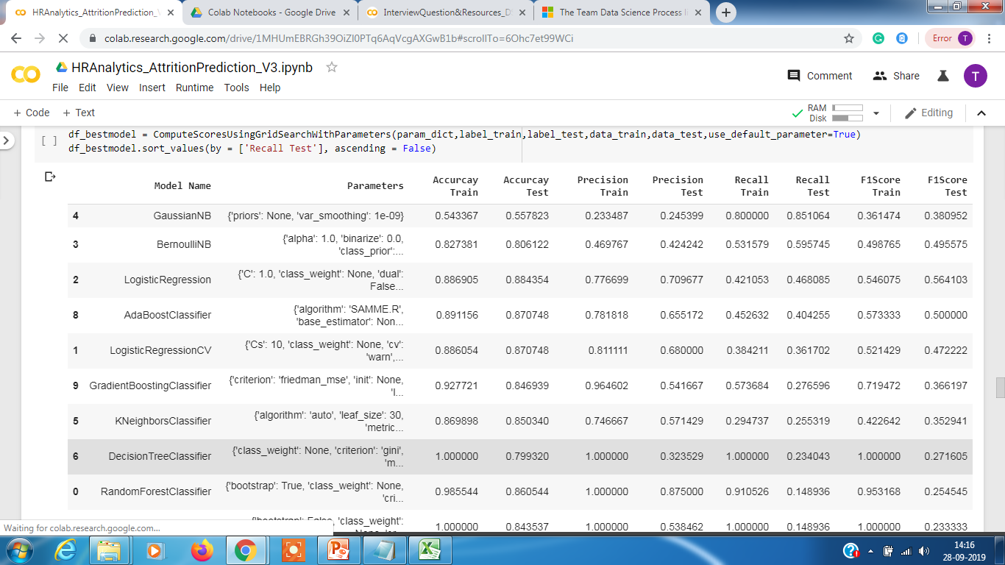
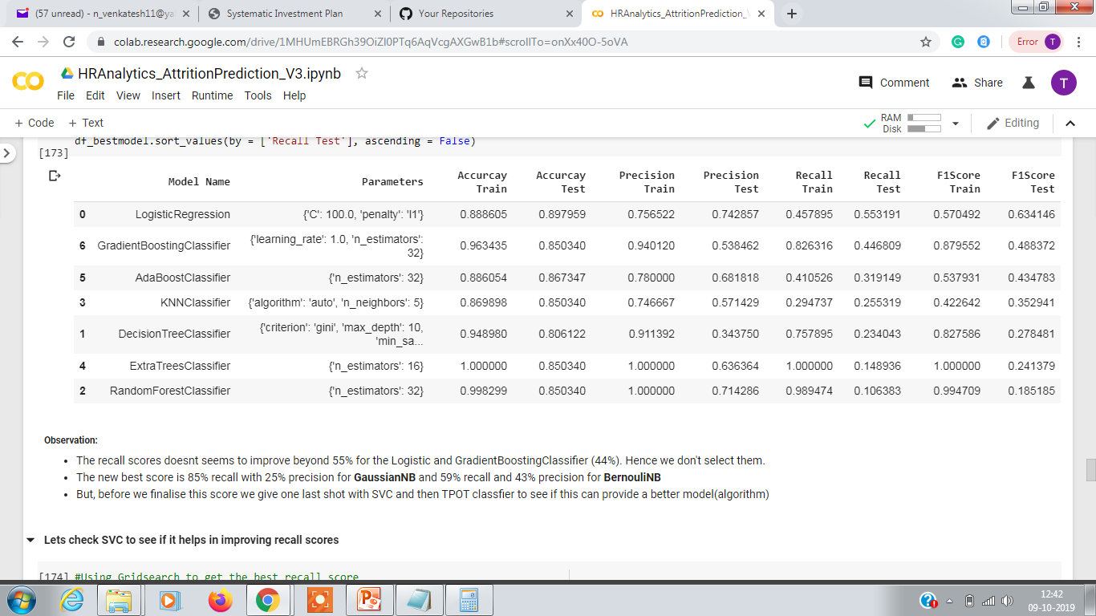
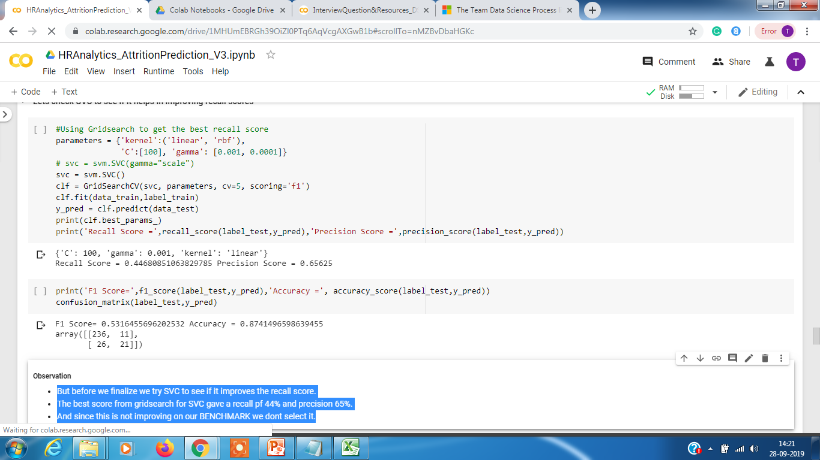
HR Analytics – Model Evaluation
Approach 5 : We check the score by preparing the data using label encoder for nominal and backwarddifference for ordinal for the categorical data.
Observation : The recall seems to have improved for GaussianNB and BernoulliNB with scores or 85% and 59% and its an improvement from our benchmark score of 56% for GaussianNB or 51% for Bernoulli. Hence this becomes our new BENCHMARK. The Logistic showed 55% recall and 75% precision.
.
Approach 5 : We try SVC model to see if it improves the accuracy
Observation : But before we finalize we also tried SVC to see if it improves the recall score. The best score from gridsearch for SVC gave a recall of 44% and precision 65%. And since this is not improving on our BENCHMARK we don't select it.

Slide 13
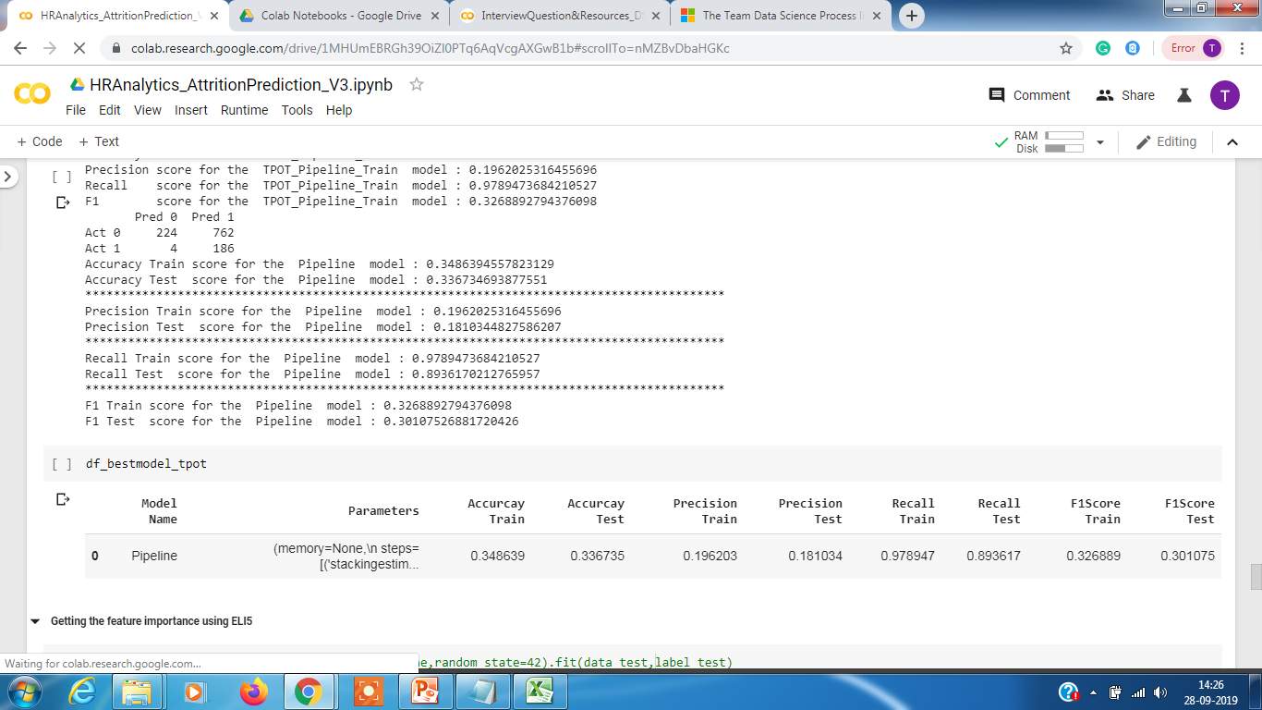
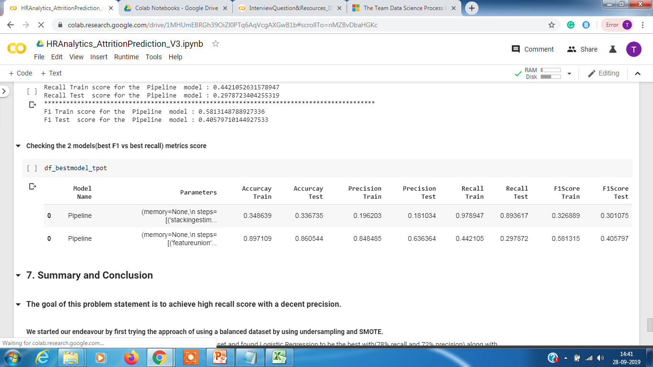
HR Analytics – Model Evaluation
Approach 6 : Using TPOT to see best recall model
Observation : The recall seems to have improved for TPOT with score of 89% but the precision dropped to 18%. Lets check what best f1 model we get
Approach 6 : Using TPOT to see best f1 model
Observation : The best F1 is 40% with recall of 29% and precision 63%.

Slide 14
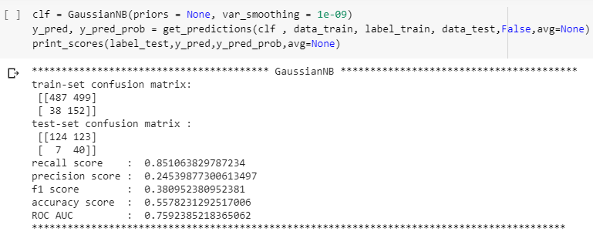
HR Analytics – EDA Summary
The best model that was found for achieving maximum recall score were GaussianNB and BernoulliNB which gave the recall scores of 82% and 57% respectively. However, there are couple of things to note before opting for this model
Though the recall score is 82% for GaussianNB but the precision is pretty low 24%. This means the model though is able to identify 82% of the attrition cases accurately but it is also misclassifying 76% of non attrition cases as attrition. And, if we were to implement this model then it would involve a lot of work to the HR team to implement its mitigation policy or retention policy as this would mean potentially running through more than half the population to try and convince them to stay. This would also incur additional costs which might be unnecessary.

Slide 15
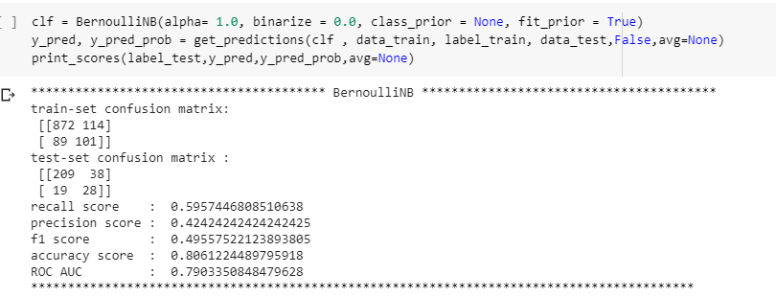
HR Analytics – EDA Summary
The BernolliNB on the other had a recall of 59% but better precision 42%. But this also has the same problem where a there were misclassification of 58% and unable to identify 41% of probable employees. This means HR team will loose 40% of the employees even after counselling and implementing retention on more than 20-25% or their employees(slightly less overhead to HR team but company would still loose 40%)

Slide 16
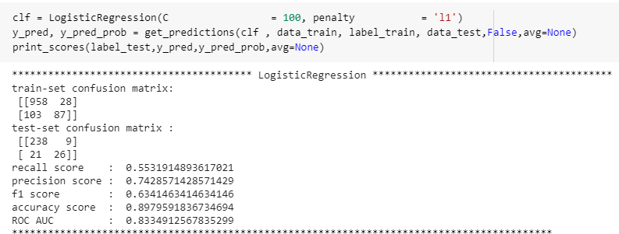
HR Analytics – EDA Summary
Let us also see the Logistic Regression which gave an recall score of 55% with 75% precision. This means the HR team would have to invest time and resources on counselling 10-15% of its population and would be still able to save 55% of its employees from quitting.
This in my opinion seems to be the best model to choose as there is an optimal trade off between the administrative cost and employees saved. However, if the company is more aggressive on saving its employees it can switch to GaussianNB.

Slide 17
HR Analytics – EDA Conclusion
After analysing the 3 models the recommendation would be to choose Logistic Regression which gives a recall of 55% with 75% precision
HR teams will be able to save 55% of its employees from the risk of attrition, which is on par with BernoulliNB (59%) but has a better precision.
HR teams time and resources spent on only 10-15% as against using GaussianNB which though has 85% correct identification but the HR team has to spend time and resources on more than half the population (55%) in order to achieve that.

Slide 18
HR Analytics – Future Considerations
Final thoughts
The TPOT should be used to create or measure baselines.
One of the best practice identified is that models give the optimal results when data is prepared using label encoder for nominal data and using backward difference encoder for ordinal.
An exhaustive list of algorithms should be tried , here we only covered ExtraTreeClassifier, GradientBoostClassifier and AdaBoostClassifier apart from the basic ones (Logistic, DecisionTree, RandomForrest, KNN , BernouliNB and GaussianNB).
Choose F1 score over recall wherever we need both precision and recall to be optimal.
For future , The logistic regression model should be closely monitored and new information to be captured with the employees leaving the company to be used to retrain the model and see if there is any better model that emerges from the new information obtained.

Slide 19
Thank You

